Slide 1
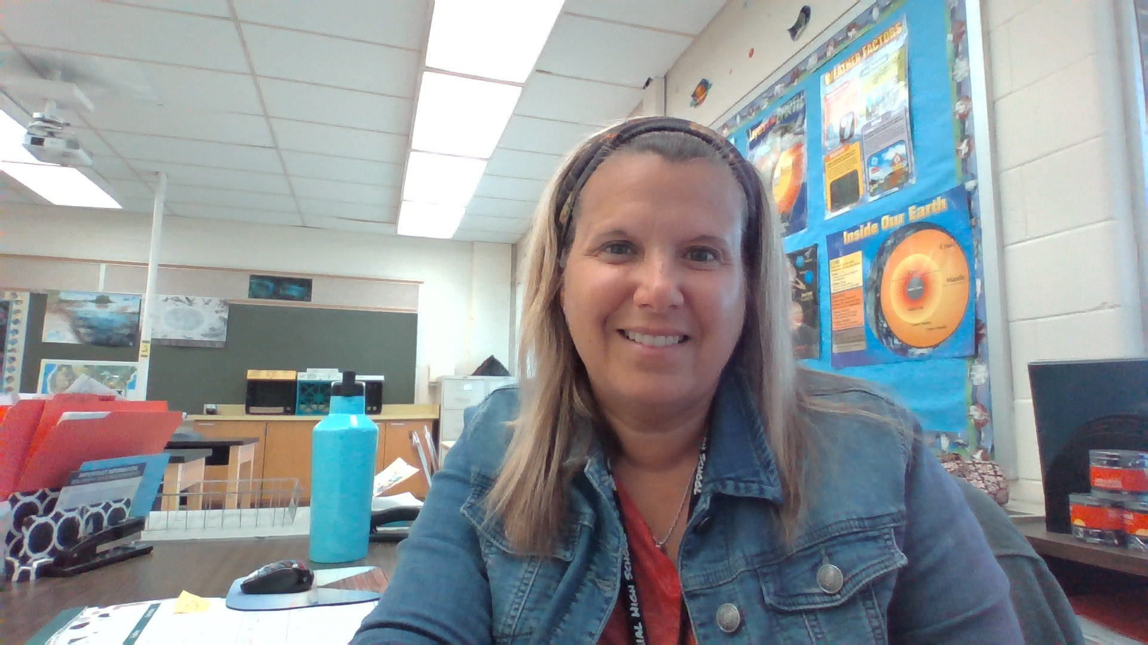
WELCOME TO EARTH/ENVIRONMENTAL
MRS. LEONE ROOM 615

Slide 2
DESCRIPTION
This course offers students an introduction to the study of Earth Science and Ecology; the environment, environmental resources, plant and animal diversity, population dynamics and adaptations, along with geological events on Earth and beyond. We will focus on the effects of our population on Earth’s environment, population growth, Earth’s systems interactions, and ecosystem function. This course is primarily internet-based using educational websites and videos to supplement class discussions about dynamic events that occur in nature that are virtually impossible to recreate in classroom lab experiences. Whenever possible, we will create and use models to illustrate Earth’s lesser complicated systems.

Slide 3
OUR CLASSROOM
It is suggested that students use a three ring binder or folder, as there will be numerous documents, which will need to be kept in an organized manner. These will include handouts, lab reports, homework assignments, and graded tests and quizzes.

Slide 4
GOOGLE CLASSROOM
Our Google Classroom Code: 63mazgz
Most course materials will be posted on our Google classroom. This includes videos, assignments and PowerPoints used in class.
Students can download and print any lost PowerPoint, assignments or labs from this site. In addition, if students are absent, they should review Google Classroom activity from that day and can make an appointment for a meeting to make up any missing work.

Slide 5
EXPECTATIONS
Students are expected to arrive in class promptly with their binder or folder, pencils, chromebook and other required materials. Students will be seated, ready to begin, prior to the bell indicating the start of class. Students also are expected to know how to work the google classroom. All work and necessary materials will be posted daily for any student that needs a copy of any work or assignments. Completed assignments may be posted on the google classroom or can be turned in as a hard copy in class.

Slide 6
MATERIALS
Students must keep an organized folder or binder. Students are required to have all materials in class and ready to use when class starts, unless informed otherwise. Students will be assigned a textbook or can be assigned an online textbook.
The following material is to be brought to each class.
Pen/Pencil (preferably more than one of each)
3 Ring Binder or folder
Computer Access/ Chromebook

Slide 7
GRADING
Assessments – TESTS, PROJECTS & QUIZZES 40%
Participation - Virtual Labs, Video Assignments (Web Quest or Edpuzzle) 35%
Homework/Classwork – Vocabulary Assignments, Worksheets, and Warm-up Questions 25%

Slide 8
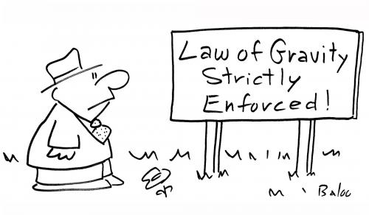
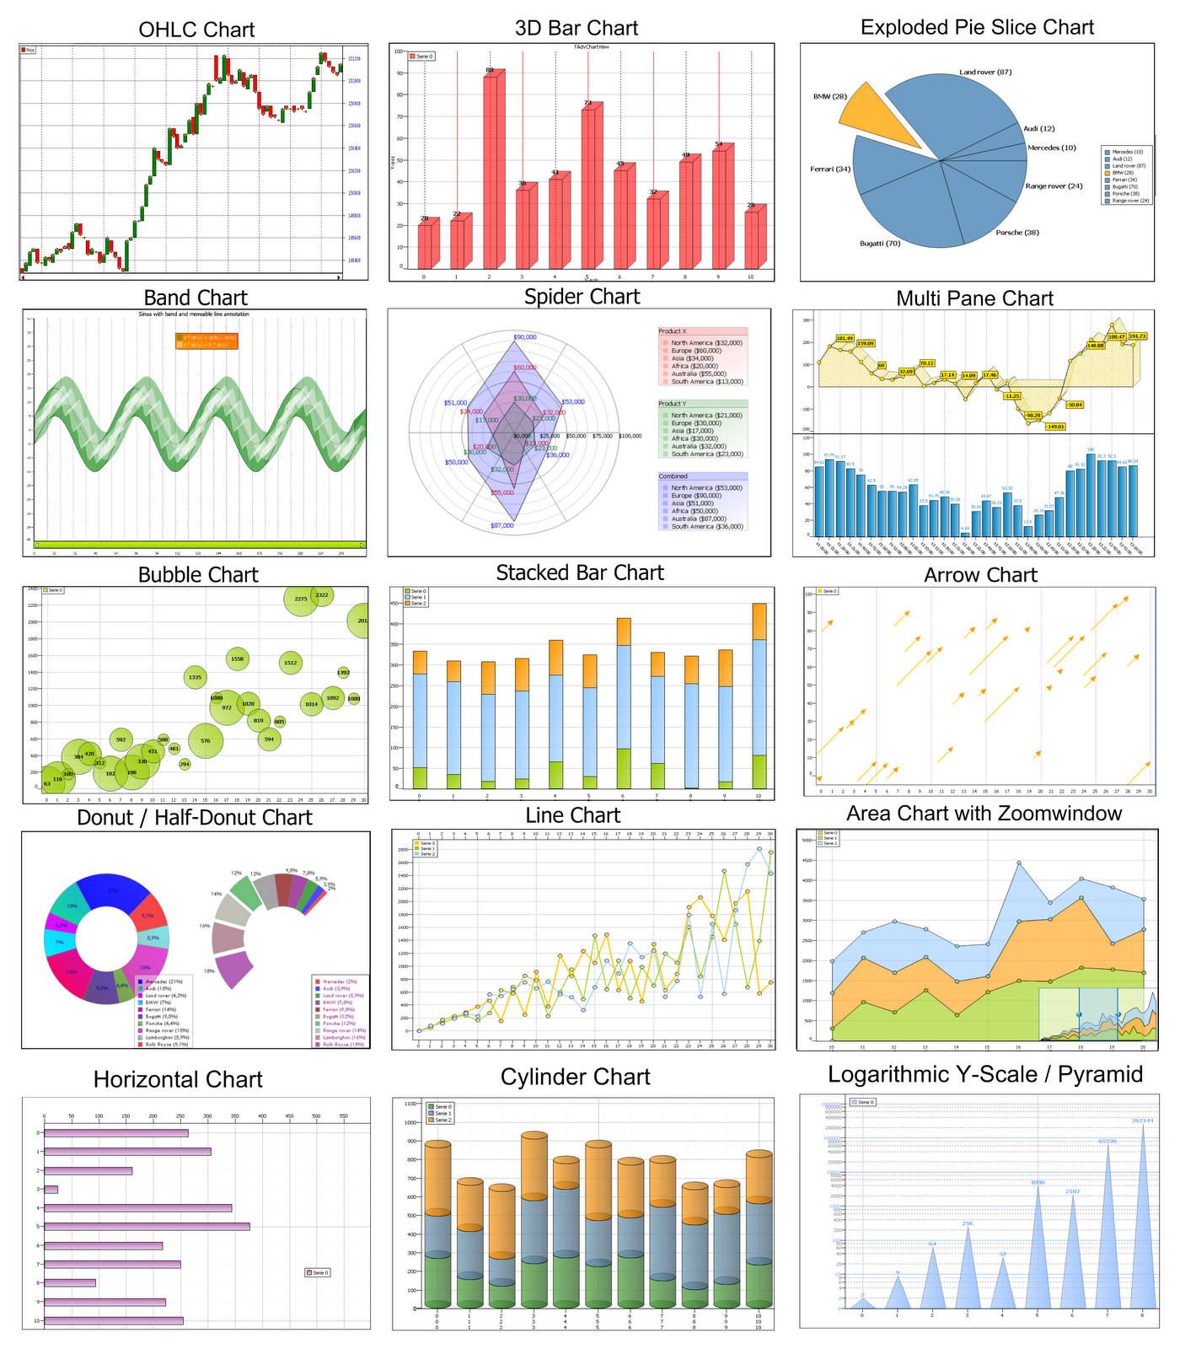
UNIT I – INTRODUCTION TO SCIENCE
This Photo by Unknown Author is licensed under CC BY-NC
This Photo by Unknown Author is licensed under CC BY-SA
This Photo by Unknown Author is licensed under CC BY-ND

Slide 9
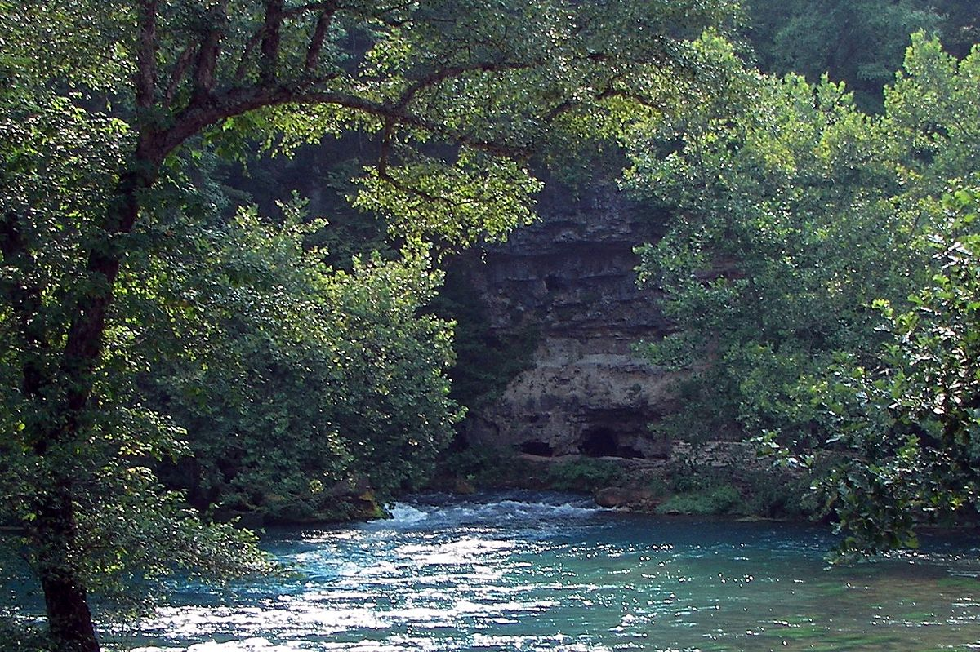
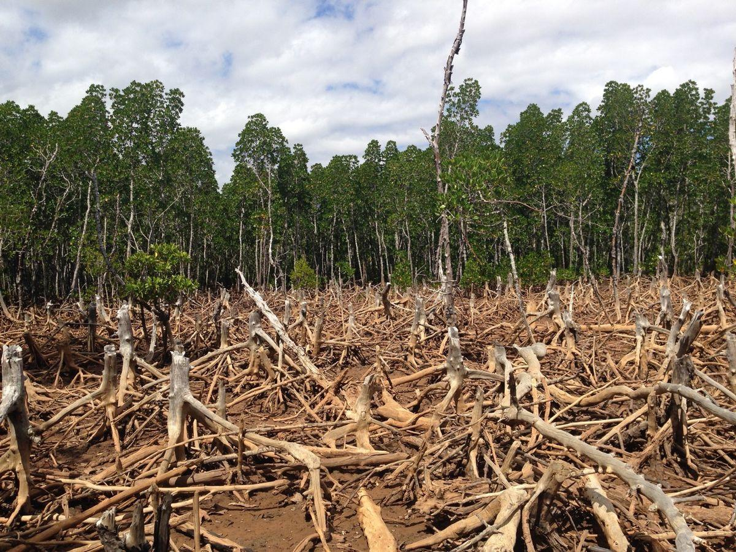
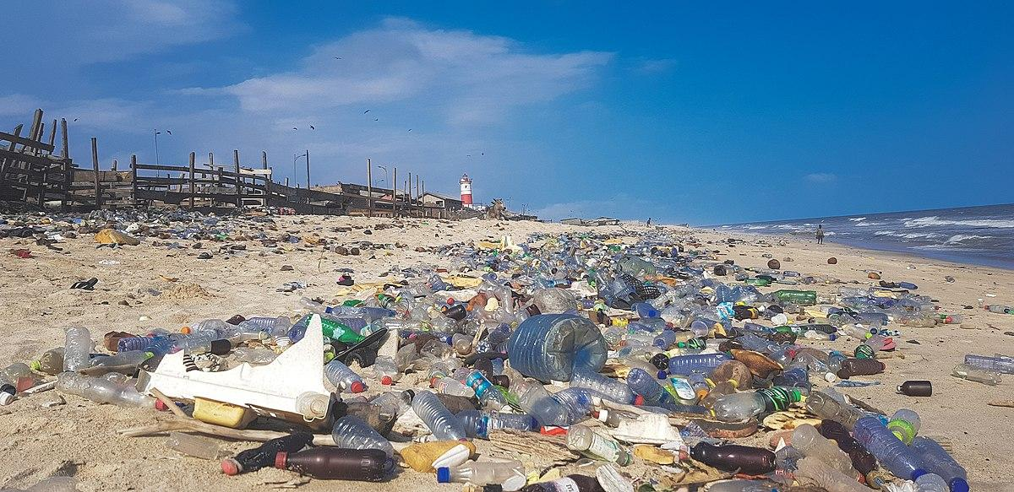
UNIT 2 ENERGY AND HUMAN IMPACT
This Photo by Unknown Author is licensed under CC BY-ND
This Photo by Unknown Author is licensed under CC BY-SA
This Photo by Unknown Author is licensed under CC BY-SA
This Photo by Unknown Author is licensed under CC BY-SA

Slide 10
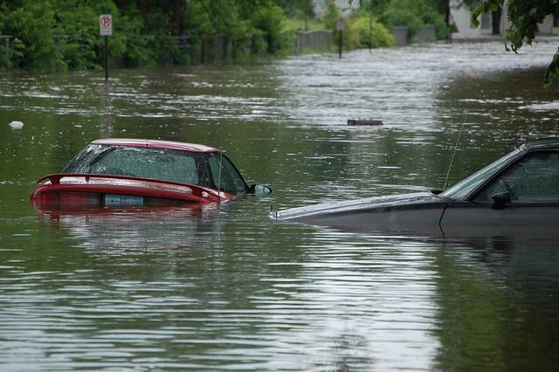
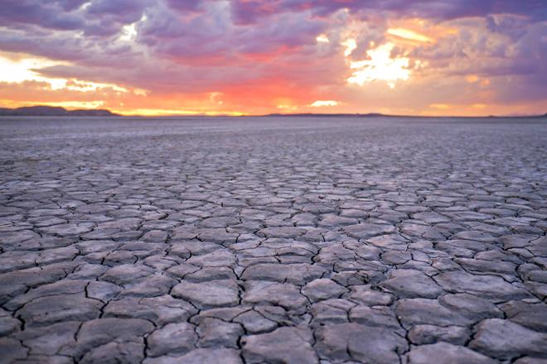
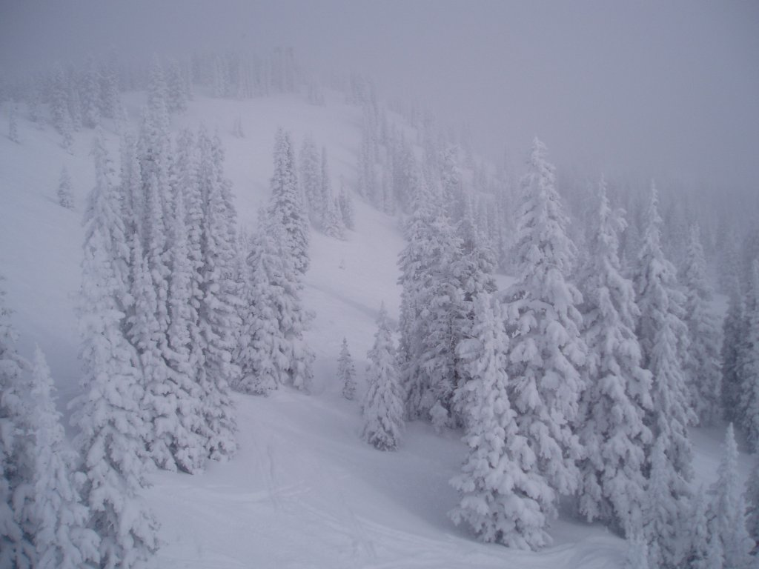
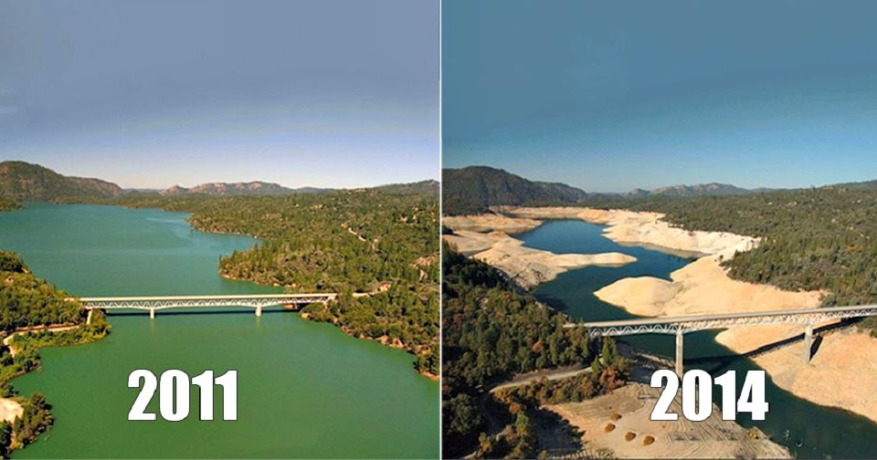
UNIT 3 ATMOSPHERE AND CLIMATE
This Photo by Unknown Author is licensed under CC BY-NC
This Photo by Unknown Author is licensed under CC BY-SA
This Photo by Unknown Author is licensed under CC BY
This Photo by Unknown Author is licensed under CC BY-NC-ND
This Photo by Unknown Author is licensed under CC BY

Slide 11
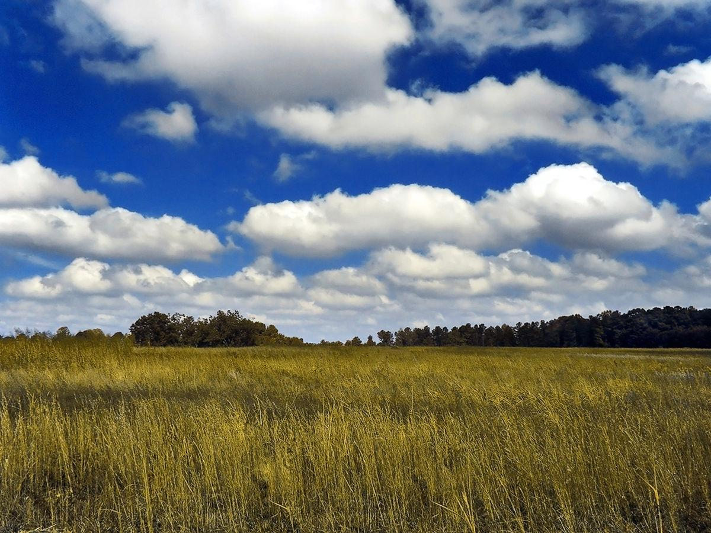
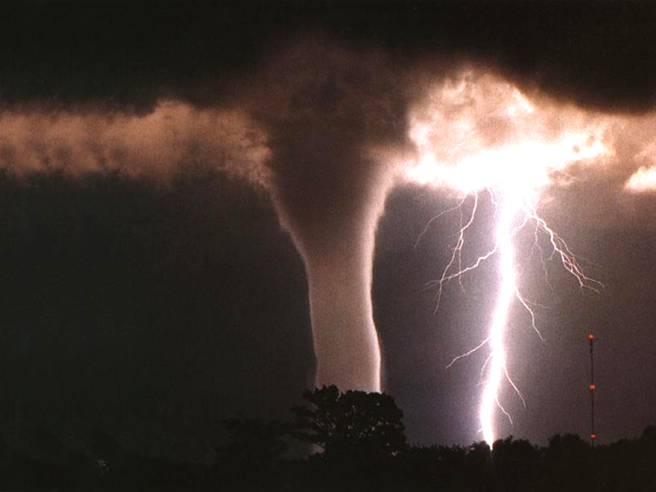
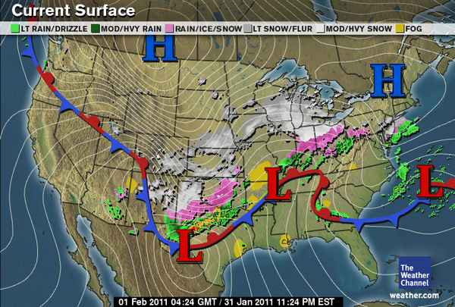
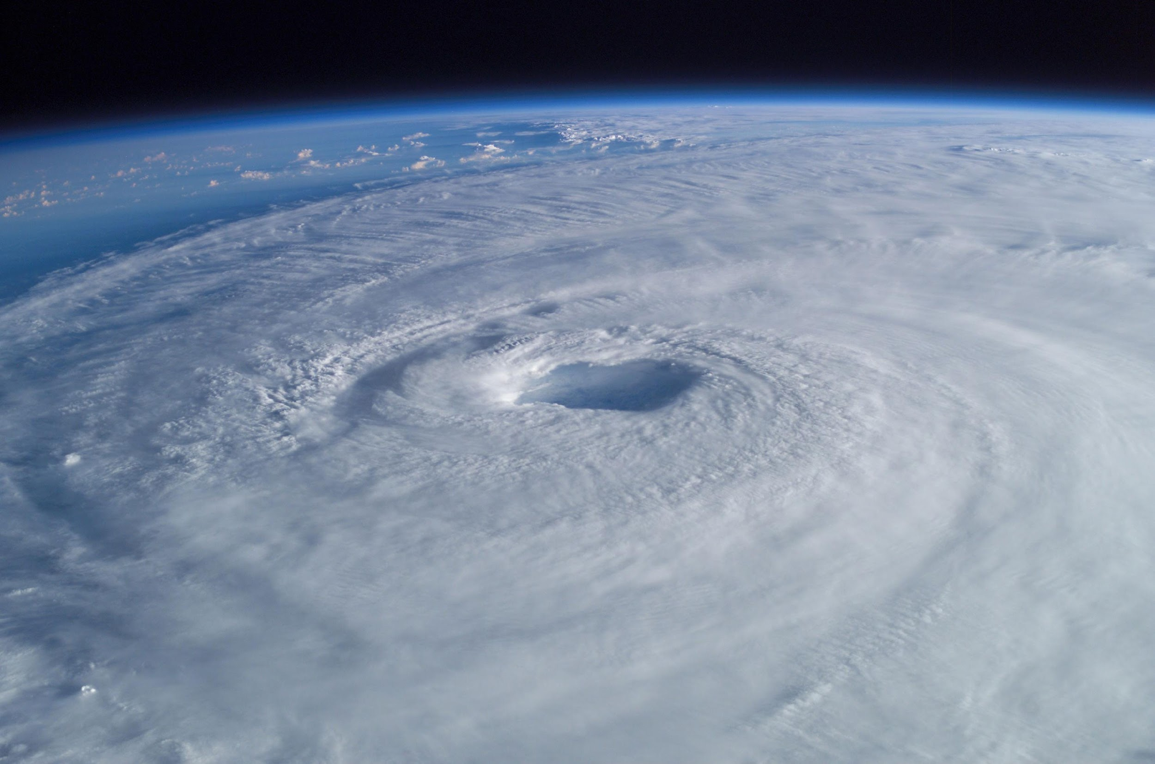
UNIT 4 WEATHER/ STORMS
This Photo by Unknown Author is licensed under CC BY-SA

Slide 12
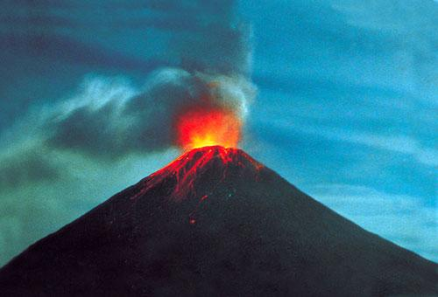
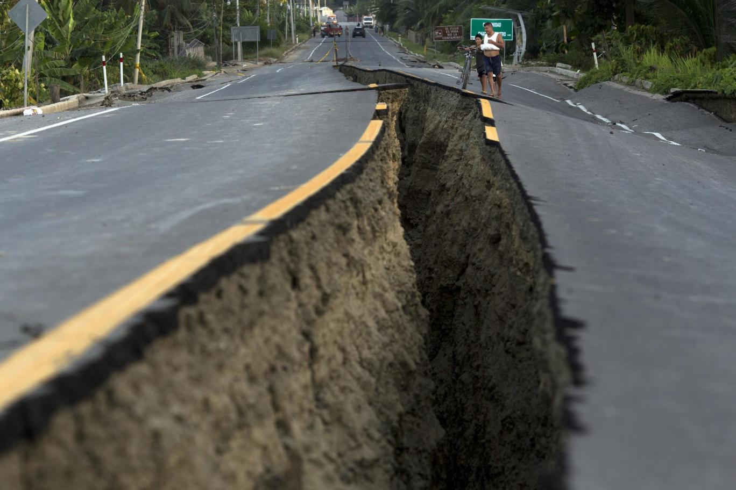
UNIT 5 PLATE TECTONICS/ VOLCANOES
This Photo by Unknown Author is licensed under CC BY-SA
This Photo by Unknown Author is licensed under CC BY-SA
This Photo by Unknown Author is licensed under CC BY-SA-NC

Slide 13
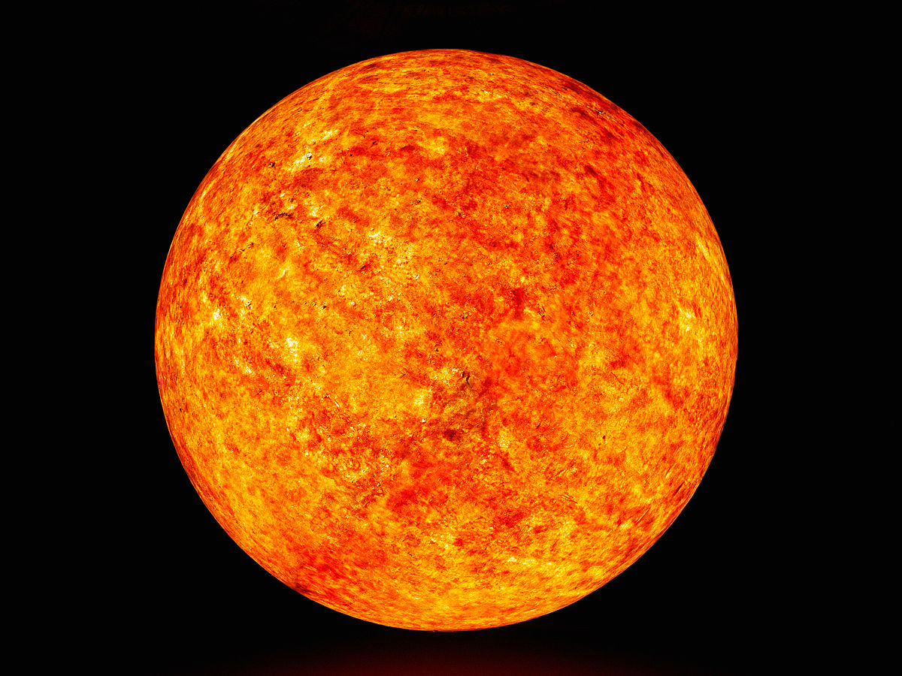
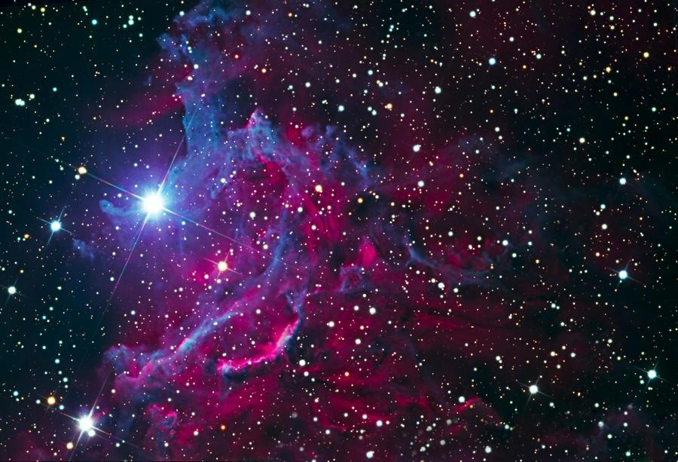
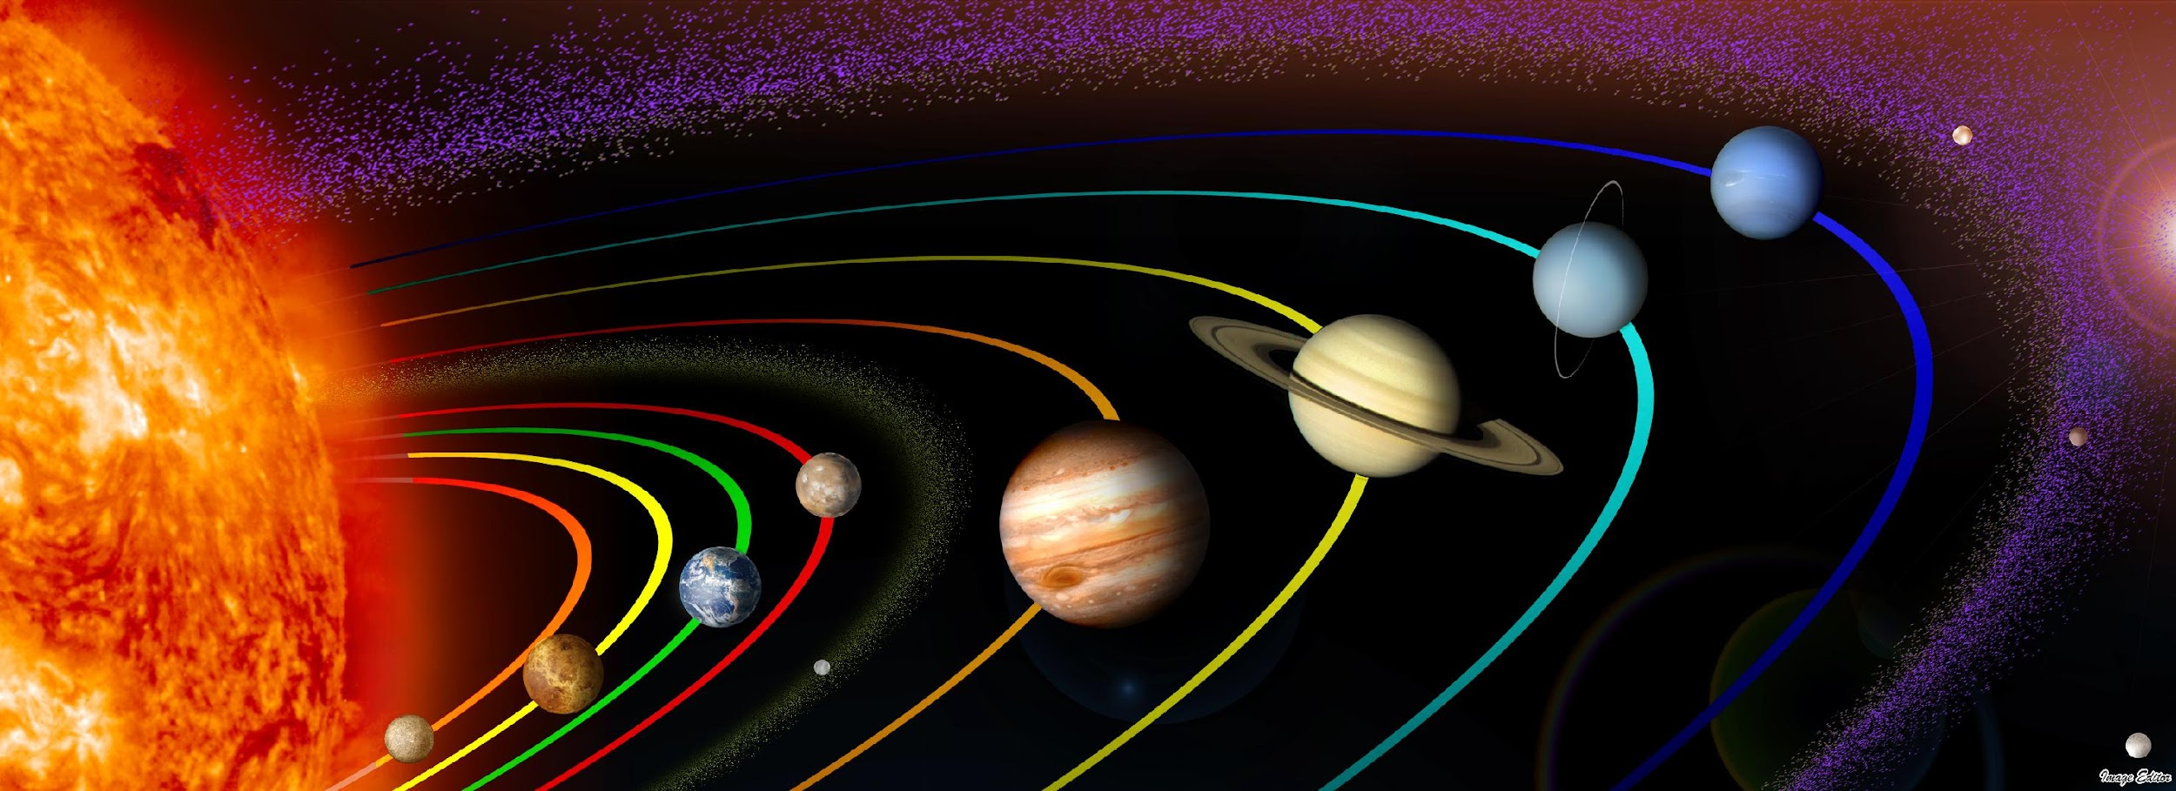
UNIT 6 SPACE/ GALAXIES
This Photo by Unknown Author is licensed under CC BY-SA
This Photo by Unknown Author is licensed under CC BY-NC
This Photo by Unknown Author is licensed under CC BY-NC
This Photo by Unknown Author is licensed under CC BY

